Slide 1
Lecture 03
The writing process

Slide 2
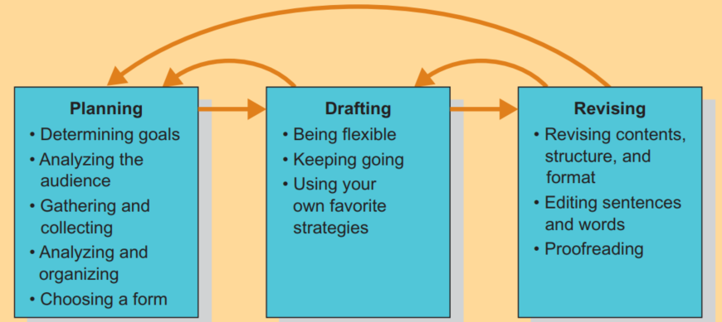
The process of writing

Slide 3
The process of writing
The process of writing involves three broad steps - planning, drafting, and revising.
These steps are recursive, not strictly linear.
Student writes should spend roughly a third of their writing time in each stage

Slide 4
Forms of writing

Slide 5
Letters
Letters are the oldest form of business messages
They are still an important form of business communication
The general purpose of a letter is to represent the writer and his or her topic rather formally to the recipient.
For this reason, letters are used primarily for corresponding with people outside your organization like customers, suppliers, citizens, community leaders, etc.
Once you have established friendly relations with them, you may well conduct your business through emails and phone calls.

Slide 6
Letters
As to the format of the layout, any generally recognized one is acceptable.
Generally, the most popular formats are block, modified block, and simplified.
In all formats, single-spacing in paragraphs and double spacing between paragraphs is the general rule.

Slide 7
Letters
Full Block - In a full block business letter, every component of the letter (heading, address, salutation, body, salutation, signature, identification, enclosures) is aligned to the left.
Also, first sentences of paragraphs are not indented
Modified block - In a modified block business letter, the heading, complimentary close, the signature, and identification are aligned to the right. Address, salutation, the body, and enclosures are aligned to the left.
First sentences of paragraphs may or may not be indented.

Slide 8
Letters
Dateline - You should use the conventional date form, with month, day, and year (September 17, 2012).
Abbreviated date forms such as 09-17-12 or Sept. 17, ’12 are informal and leave unfavorable impressions on some people.
Return Address - In most cases, your return address is printed on the letterhead or filled in on it during automated formatting.
Inside Address - The mailing address, complete with the title of the person being addressed, makes up the inside address. Preferably, form it without abbreviations, except for commonly abbreviated words (Dr., Mr., Ms.).

Slide 9
Letters
Attention Line - Some executives prefer to emphasize the company address rather than the individual offices.
Thus, they address the letter to the company in the inside address and then use an attention line to direct the letter to a specific officer or department.
The attention line is placed two lines below the inside address and two lines above the salutation.
Ex:
Attention: Mr. Donovan Price, Vice President

Slide 10
Letters
Salutation - If the writer and the reader know each other well, the salutation may be by first name, Dear Joan.
A salutation by last name, Dear Mr. Baskin, is appropriate in most cases.
If you do not know and cannot find out the name of the person to whom you are sending the letter, use a position title like Director of Human Resources or Public Relations Manager.

Slide 11
Letters
Women’s preferences have sharply reduced the use of Mrs. and Miss.
Many writes ask why we distinguish between married and single women when we make no such distinction between married and single men.
The logical solution is to use Ms. for all women, just as Mr. is used for all men. If you know that the woman you are writing has another preference, however, you should adhere to that preference

Slide 12
Letters
Subject Line - For both the sender and the receiver to quickly identify the subject of the correspondence.
In addition, it contains any specific identifying material that may be helpful: date of previous correspondence, invoice number, order number, and the like.
It is usually placed two lines below the salutation. Subject lines are generally written as fragments.
Ex:
Subject: Your July 2nd inquiry about . . .
RE: Please refer to Invoice H-320

Slide 13
Letters
Second Page Heading - When the length of a letter must exceed one page, you should set up the following page or pages for quick identification.
Always print such pages on plain paper (no letterhead).
Most standard templates automatically insert this information—name of addressee, date, and page number—on the second and following pages of your letter.

Slide 14
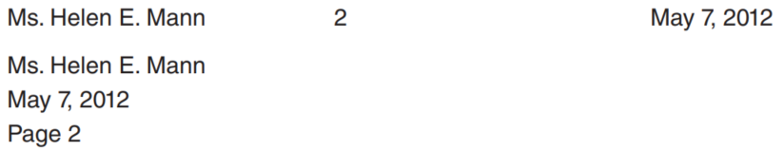
Letters
These two forms are the most common:

Slide 15
Letters
Closing - By far the most commonly used complimentary close is Sincerely.
Sincerely yours is also used, but in recent years the yours has been fading away.
Truly (with and without the yours) is also used, but it also has lost popularity.
Such closes as Cordially and Respectfully are appropriate when their meanings fit the writer–reader relationship.

Slide 16
Letters
A long-standing friendship, for example, would justify Cordially; the writer’s respect for the position, prestige, or accomplishments of the reader would justify Respectfully.
Signature Block - The printed signature conventionally appears on the fourth line below the closing, beginning directly under the first letter for the block form.

Slide 17
Letters
Mixed or Open Punctuation - Mixed punctuation employs a colon after the salutation and a comma after the complimentary close.
Open punctuation, on the other hand, uses no punctuation after the salutation and none after the complimentary close.
These two forms are used in domestic communication.
In international communication, you may see letters with closed punctuation—punctuation distinguished by commas after the lines in the return and inside addresses and a period at the end of the complimentary close.

Slide 18
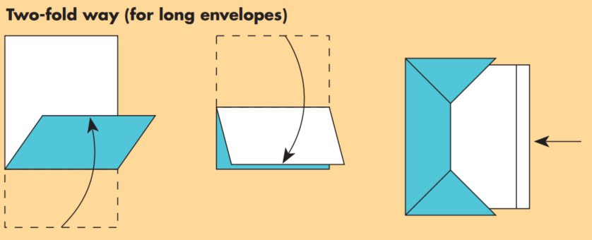
Letters
Folding the letter -

Slide 19
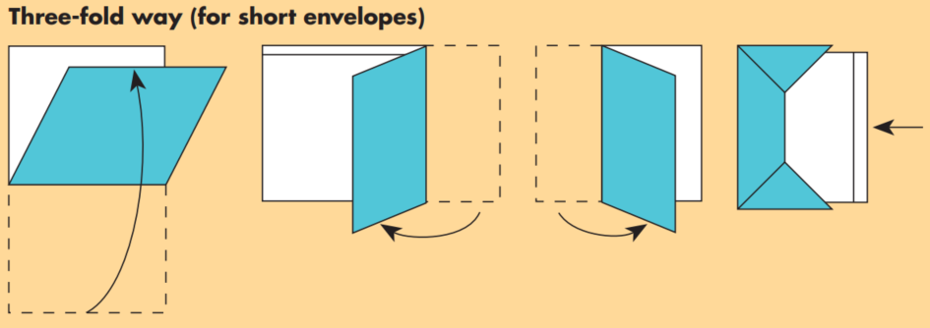
Letters
Folding the letter -

Slide 20
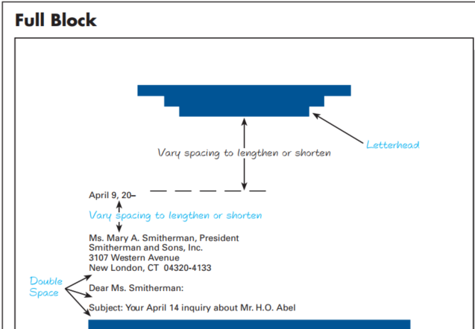

Slide 21
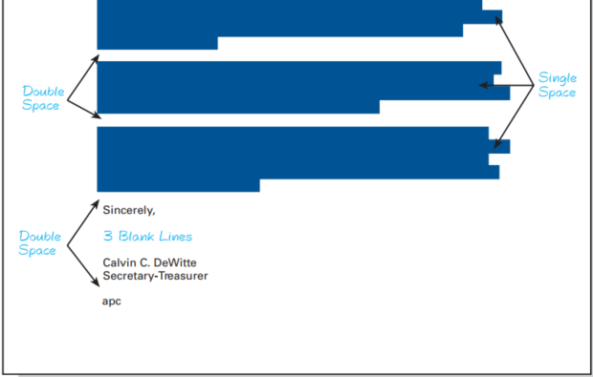

Slide 22
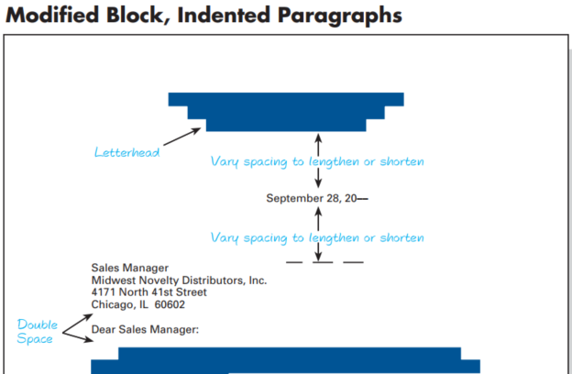

Slide 23
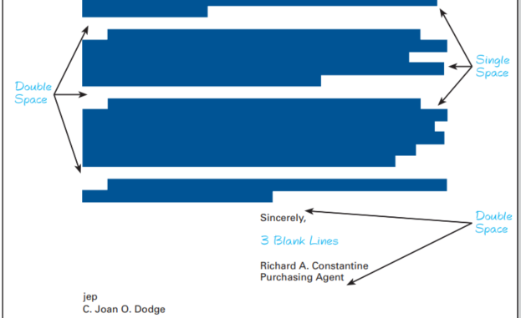

Slide 24
Memos

Slide 25
Memos
Memorandums, or memos, are a form of letter written inside the business. They are usually exchanged internally by employees in the conduct of their work.
They are especially useful in communicating with employees who do not use computers in their work.
Memorandums can be distinguished from other messages primarily by their form.
Sometimes the word memorandum appears at the top in large, heavy type.

Slide 26
Memos
But some companies prefer other titles, such as Interoffice Memo.
Below this main heading come the specific headings common to all memos: Date, To, From, Subject (though not necessarily in this order).
Hard-copy memos are usually initiated by the writer rather than signed.

Slide 27
Memos
Large organizations, especially those with a number of locations and departments, often include additional information on their memorandum stationery. Department, Plant, Location, Territory, Store Number, and Copies.
Since in some companies memos are often addressed to more than one reader, the heading To may be followed by enough space to list a number of names.

Slide 28
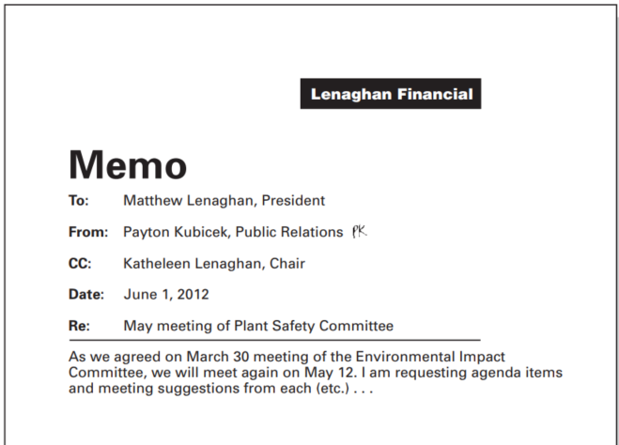
Memos

Slide 29
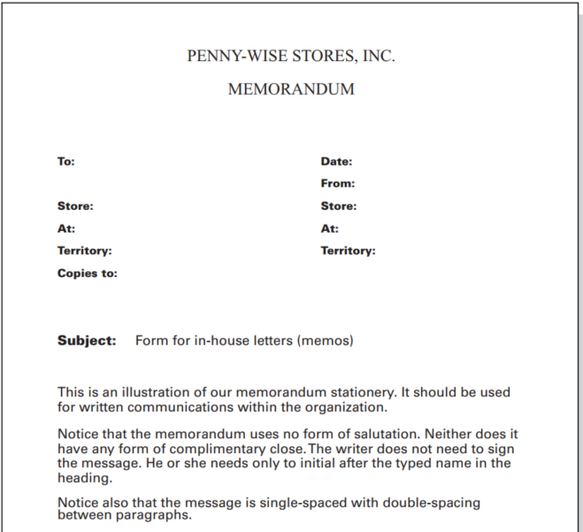
Memos

Slide 30
Email

Slide 31
Email
In just a short time, email has become a mainstream form of business communication.
Pros -
Eliminates the problem of trying to contact busy people who are not always available for telephone calls
Saves the time of these busy people.
Email is cheap. It permits unlimited use at no more than the cost of an Internet connection.
It provides a written record.

Slide 32
Email
Cons -
Email is not confidential. Any message may be forwarded or shared without the writer’s knowledge.
Email doesn’t communicate the sender’s emotions well. Voice intonations, facial expressions, and body movements are not a part of the message as they are in telephone, video, and face-to-face communication.
Email may be ignored or delayed. The volume of email often makes it difficult for some respondents to read and act on all of their messages quickly.

Slide 33
Email
You probably know about the components of an email - to, cc, bcc, subject, attachments, and message.
Cc: If someone other than the primary recipient is to receive a courtesy copy, his or her address goes here.
Bcc: This line stands for blind courtesy copy. The recipient’s message will not show this information; that is, he or she will not know who else is receiving a copy of the message.
And as far as how to structure your message in email or letter, we will see that in the subsequent lectures.

Slide 34
Email
The message beginning - Typically, email messages begin with the recipient’s name.
If writer and reader are acquainted, first name only is the rule. If you would normally address the reader by using a title (Ms., Dr., Mr.), address him or her this way in an initial email.
The salutations commonly used in letters (Dear Mr., Dear Jane) are sometimes used, but something less formal (“Hi, Ron”) or no salutation at all is more common.

Slide 35
Email
A friendly generic greeting such as “Greetings” is appropriate for a group of people with whom you communicate.
When writing to someone or a group you do not know, it is appropriate to identify yourself early in the message.
This identification may include your purpose and your company. Your title and position also may be helpful.
And as far as how to structure your message in email or letter, we will see that in the subsequent lectures.

Slide 36
Email
Closing - Most email messages end with just the writer’s name—the first name alone if the recipient knows the writer well.
But in some messages, especially the more formal ones, a closing statement, complimentary close, or both may be appropriate. “Thanks” and “Regards” are popular.
The more formal complimentary closes used in traditional letters (sincerely, cordially) are not widely used, but they are appropriate in messages that involve formal business relationship

Slide 37
Inappropriate use of Email
Email is not always a good medium for your communications. It should not be used when:
The message is long, complicated, or requires negotiation.
Questions or information need clarification and discussion.
The information is confidential or sensitive, requires security, or could be misinterpreted.
The message is emotionally charged and really requires tone of voice or conversational feedback to soften the words or negotiate meaning.

Slide 38
Inappropriate use of Email
The message contains sensitive issues, relays feelings, or attempts to resolve conflict. Email can make conflict worse.

Slide 39
Discussion / debate

Slide 40
Discussion / debate
Will hard-copy letters diminish in importance as email continues to grow? Become obsolete? Vanish?
Some authorities say that concerns about correctness inhibit a person’s email communication. Does this view have merit? Discuss.
Memorandums and email messages can differ more than letters in their physical makeup. Explain and discuss.
Explain the logic of using negative words in email and memos to fellow employees that you would not use in letters carrying similar messages

Slide 41
Exercises

Slide 42
Discussion / debate
Interview a working professional about his or her writing process. In addition to asking about general strategies for different kinds of writing, ask how he or she tackled a particularly difficult writing situation. Write up the results of your findings in a brief memo to your instructor.
Find a sample of business writing and evaluate its use of formatting elements. If they are effective, say why; if not, explain what you would do differently

Slide 43
Discussion / debate
Assume the role of a hotel manager.
The air conditioning has stopped functioning on one of the busiest and hottest weekends of the year.
You need to explain the situation and what you are going to do (or have done) about it to three audiences:
your guests,
your co-workers who will be helping you solve the problem,
and your boss, who will not be at the hotel until Monday.

Slide 44
Discussion / debate
Develop a plan for the message you will send to each of these audiences in which you follow the five steps discussed in this chapter for planning a message.
Be sure you consider your goal in communicating with each audience, the format/ channel your communication will take, the content each audience will need, and the tone and style that will be appropriate for each audience.

Slide 45
Thank you!

